Slide 1


Slide 2


Slide 3


Slide 4


Slide 5
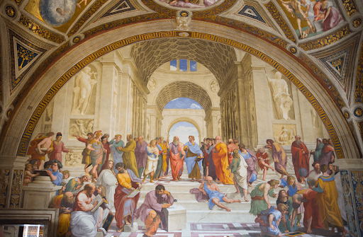

Slide 6


Slide 7


Slide 9
The additional slides below are provided so the PowerPoint can be adapted to best fit your needs.

Slide 10


Slide 11


Slide 12


